Slide 1
SELF SUSTAINABLE GOALS
ECONOMICS PROJECT
By:-
Sidharth Bhandari 16103001
Sanjana Koul 16103006
Nikhat Parveen 16103007
Riyanka Mondal 16103084
Prabhnoor Kaur 16103090
Sanyam Dhawan 16103122

Slide 2
Topics to be covered
What are self sustainable goals?
Gender Equality
Clean water and sanitation
Affordable and Clean Energy
Decent work and economic growth
Data analysis of the survey
Conclusion
Bibliography
Annexure

Slide 3
What are these goals?
Global goals for sustainable development
193 United Nations member states on September 25th 2015 formulated
action-oriented, concise and easy to communicate, limited in number, aspirational, global in nature and universally applicable to all countries, while taking into account different national realities, capacities and levels of development and respecting national policies and priorities

Slide 4
What are these goals?
offer a non-biased
objective approach to understanding
attention on sustainable development both locally and globally.

Slide 5
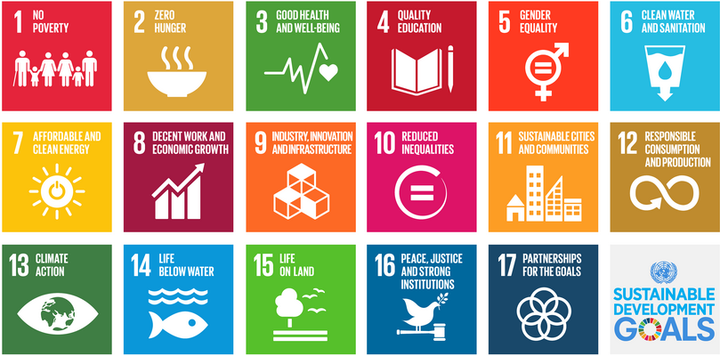

Slide 6




Topics to focus on
GENDER EQUALITY-fighting gender equalities especially violence against women
CLEAN WATER AND SANITATION-preventing disease through safe clean water and sanitation for all
AFFORDABLE AND CLEAN ENERGY-promoting clean and sustainable renewable energy sources for healthy homes and lives
DECENT WORK AND ECONOMIC GROWTH-promoting employment as a driver of inclusive economic growth

Slide 7
4. Affordable and Clean Energy
Hydroelectricity
Solar (Photovoltaic Cells)
Solar (Thermal)
Wind Energy
Geothermal Energy
Tidal Power
Biomass
Waste-to- Energy

Slide 8
Effects of renewable energy on a holistic macroeconomic framework.
renewable energy sources are generally capital intensive
have no running costs(fuel cost) long-term debt financing seem fair.
external costs of renewable are less than those of fossil fuels, particularly with respect to emissions of greenhouse gases

Slide 9
Indian scenario
recently increased its 2022 grid-connected solar energy target from 20 GW to around 100 GW.
world’s fifth largest wind energy producer, targeting 60 GW of wind energy by 2022.
24000 jobs created by solar photovoltaic (PV) projects between 2011 and 2014
45,000 Full time jobs by wind sector
creates green jobs and helps in the Economic Growth of a Country

Slide 10
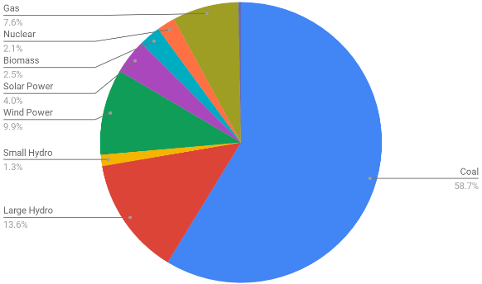

Slide 11
SURVEY

Slide 12
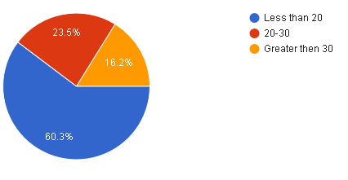
Age group
<20
20-30
>30

Slide 13
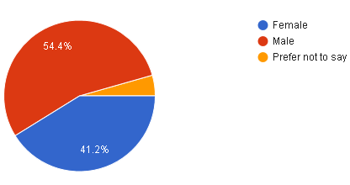
Gender
Female
Male
Other

Slide 14
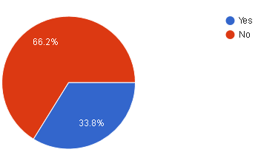
Q1. General awareness
Do you know about the sustainable development goals set by the UN?

Slide 15
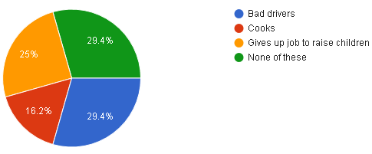
Q2. Views about women
What are the stereotypical views about women in your country?

Slide 16
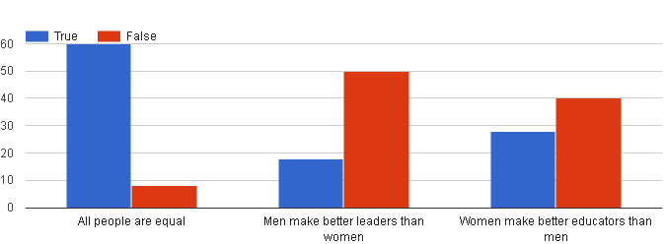
Q3. Views on gender quality
All people are equal
Men make better leaders than women
Women make better educators than men

Slide 17
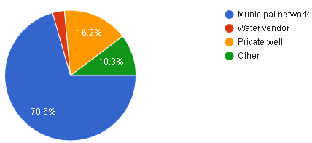
Q4. Drinking water
What is the primary source of drinking water in your household?

Slide 18
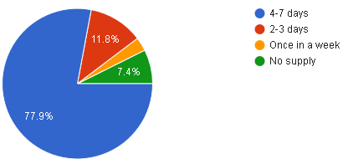
Q5. Availability of water
How often do you have running water?

Slide 19
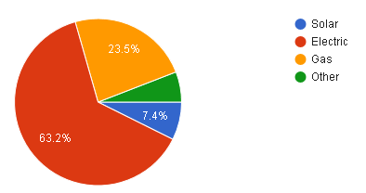
Q6. Bathing water
What is the main source of heating water for bathing?

Slide 20
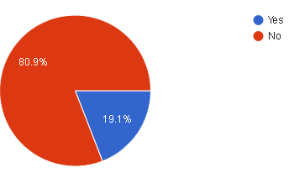
Q7. renewable energy(charity) project
Do you contribute to a renewable energy(charity) project or own renewable energy source?

Slide 21
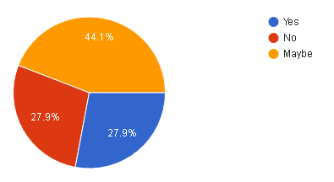
Q8. More expensive energy supplier
Would you switch to a more expensive energy supplier if they were more environment friendly?

Slide 22
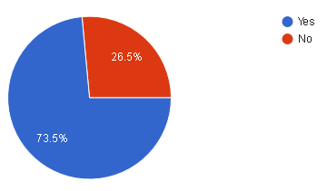
Q9. concern for renewable energy production
Are you concerned about low amounts of renewable energy being produced?

Slide 23
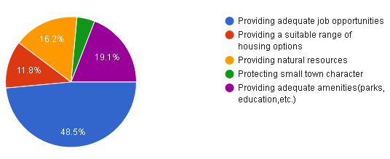
Q10. City’s Challenge
What is the city's greatest challenge?

Slide 24
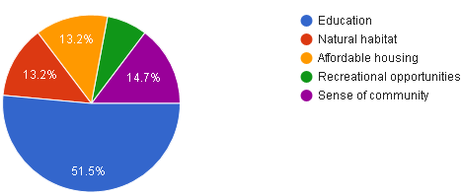
Q11. City's greatest asset
What is the city's greatest asset?

Slide 25
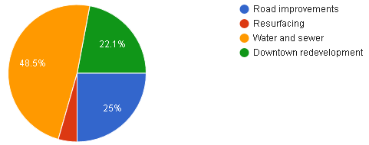
Q12. Capital improvements
Which capital improvements should the city prioritize?

Slide 26
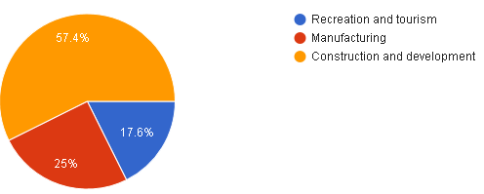
Q13. Top economic development priority
What should be the top economic development priority?

